Slide 1

SMART HOME AUTOMATION
AND SECURITY SYSTEM

Slide 2
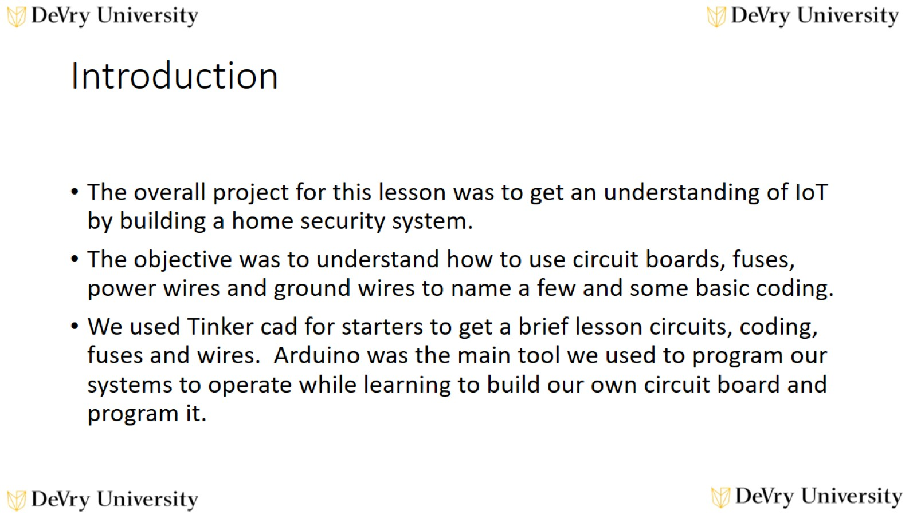
Introduction

Slide 3

CIRCUIT SIMULATION

Slide 4
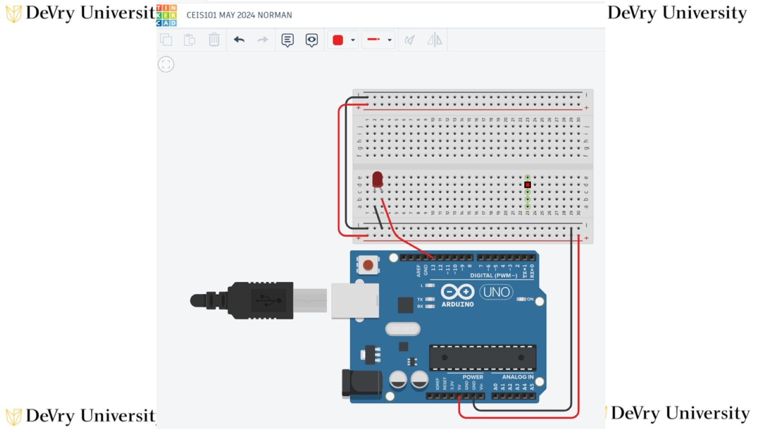

Slide 5
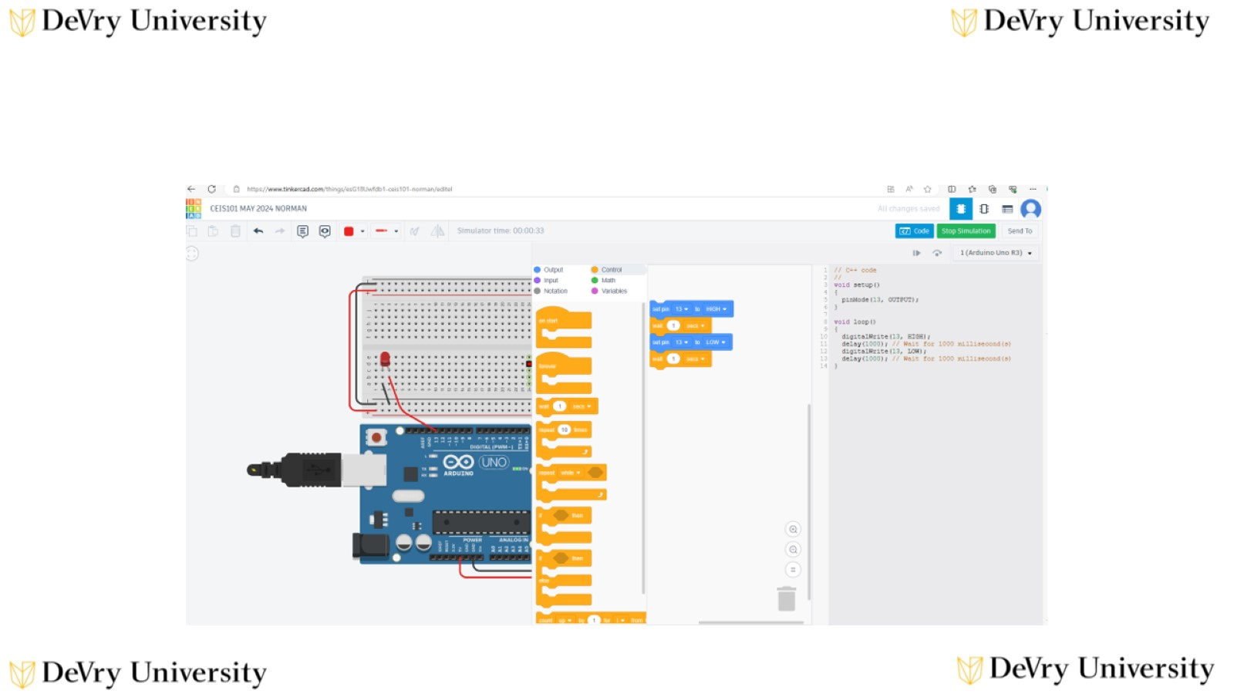

Slide 6

INVENTORY OF PARTS, CIRCUIT BUILDING AND DISPLAYING MESSAGES

Slide 7
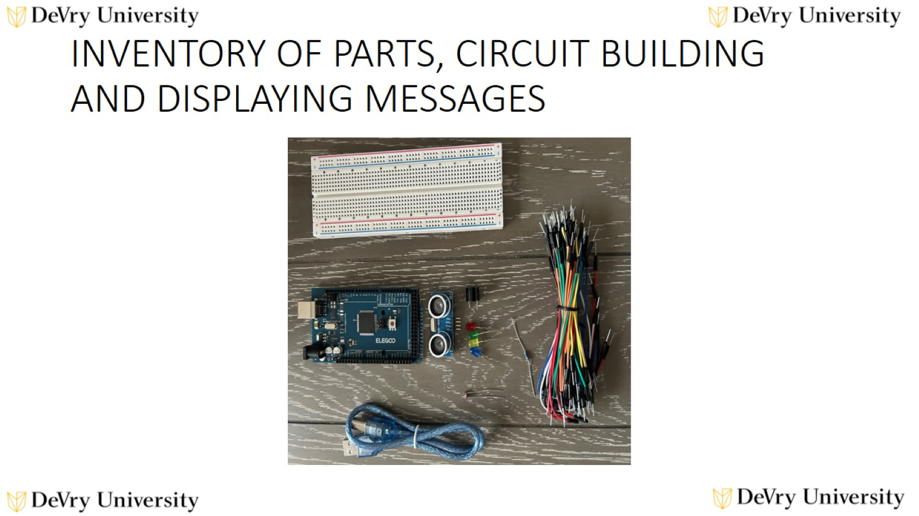
INVENTORY OF PARTS, CIRCUIT BUILDING
AND DISPLAYING MESSAGES

Slide 8
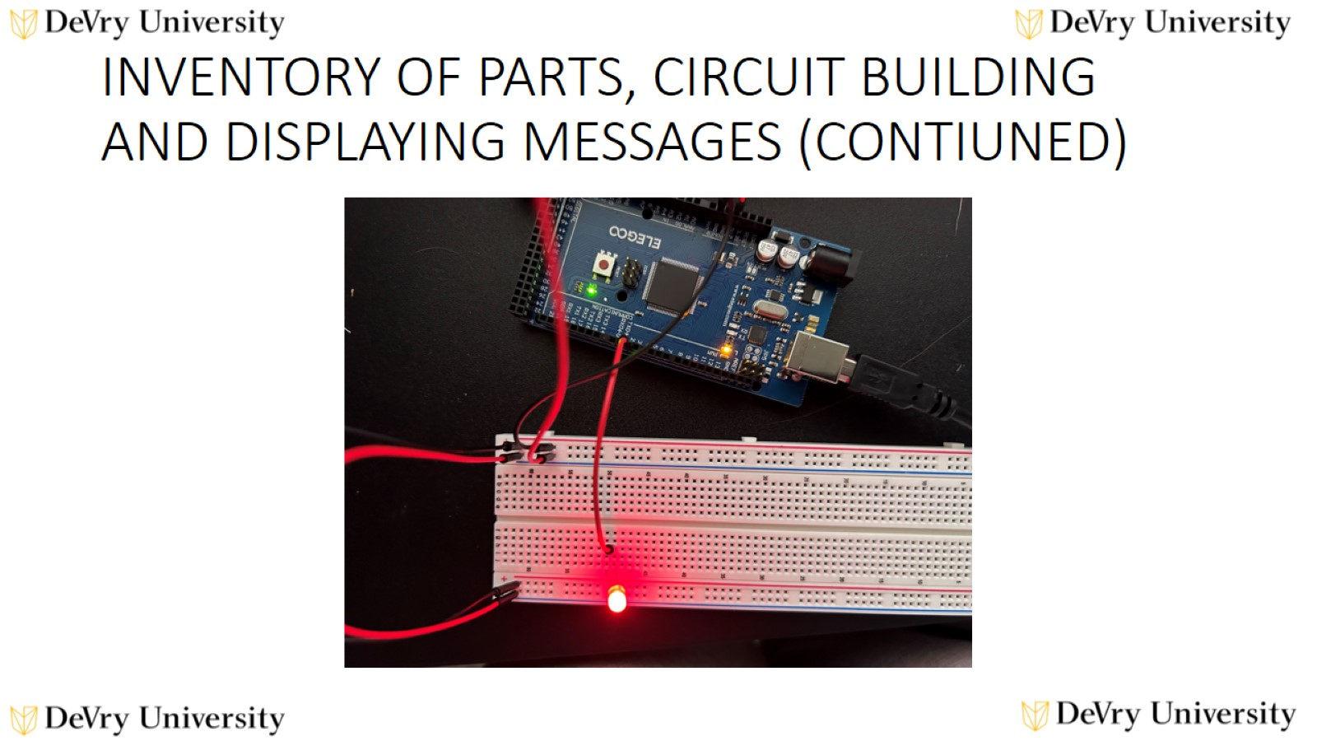
INVENTORY OF PARTS, CIRCUIT BUILDING
AND DISPLAYING MESSAGES (CONTIUNED)

Slide 9
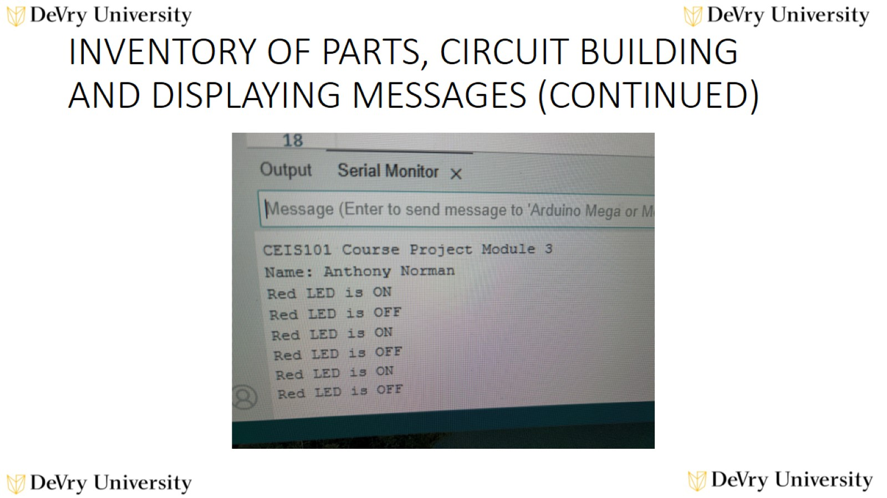
INVENTORY OF PARTS, CIRCUIT BUILDING
AND DISPLAYING MESSAGES (CONTINUED)

Slide 10
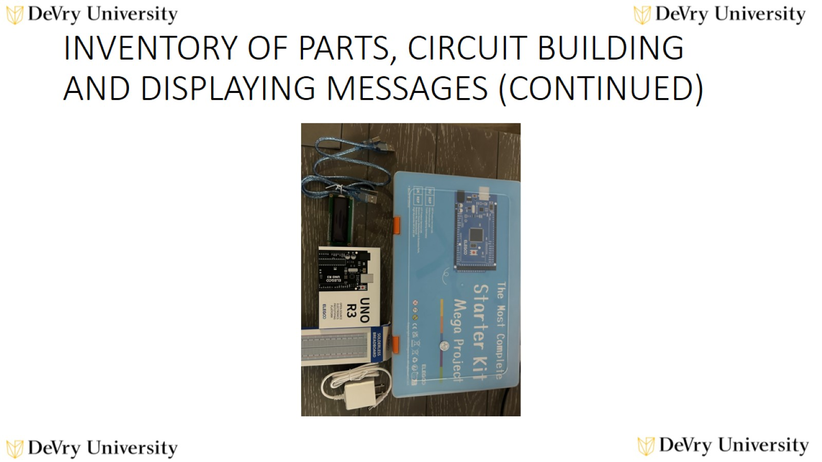
INVENTORY OF PARTS, CIRCUIT BUILDING
AND DISPLAYING MESSAGES (CONTINUED)

Slide 11

ADDING DOOR SENSOR TO SMART HOME

Slide 12
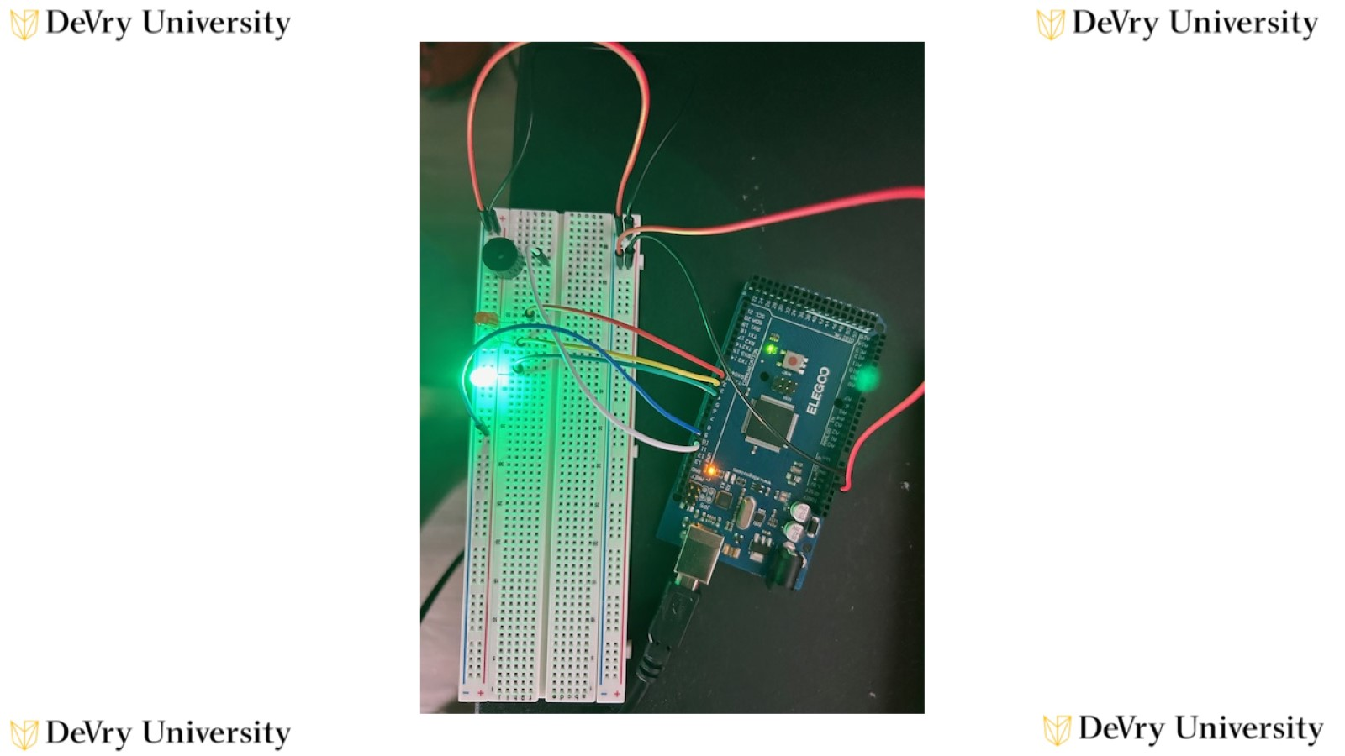

Slide 13
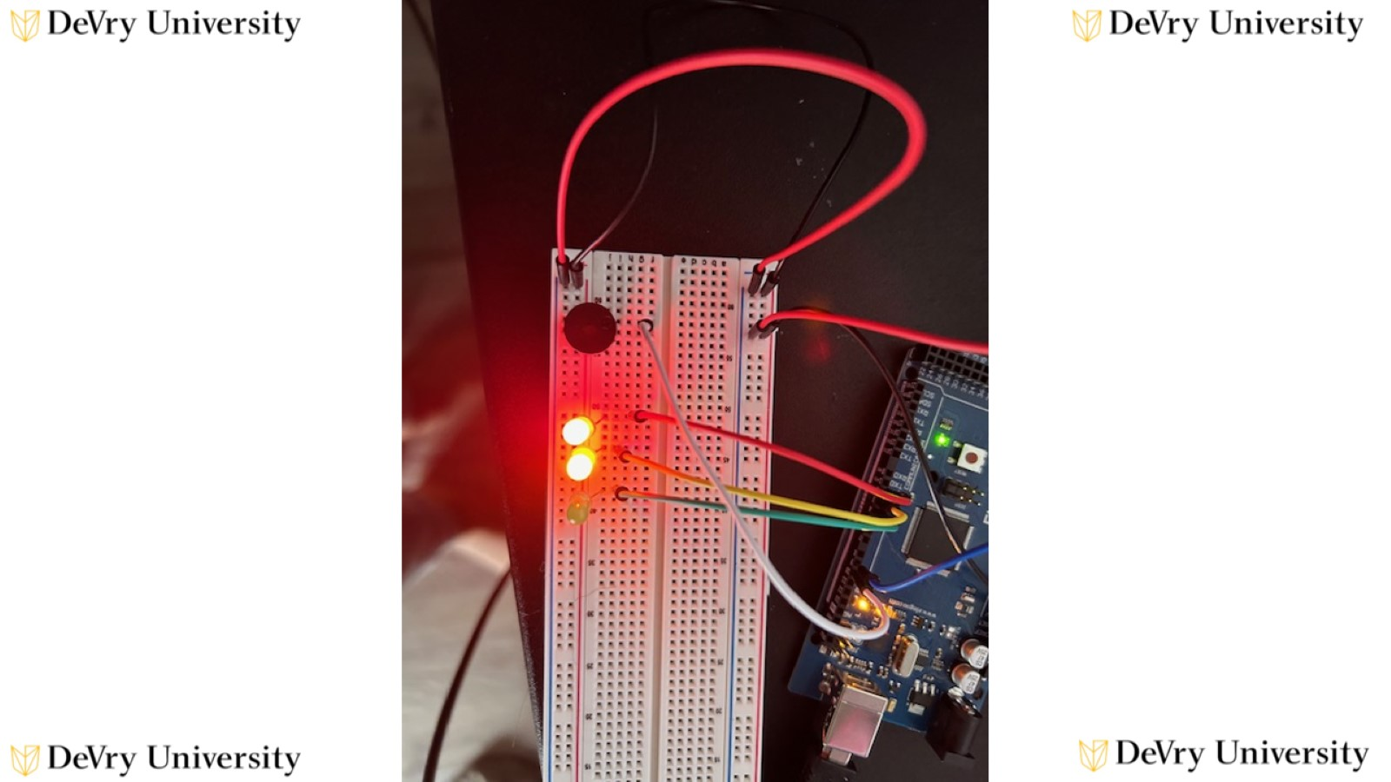

Slide 14
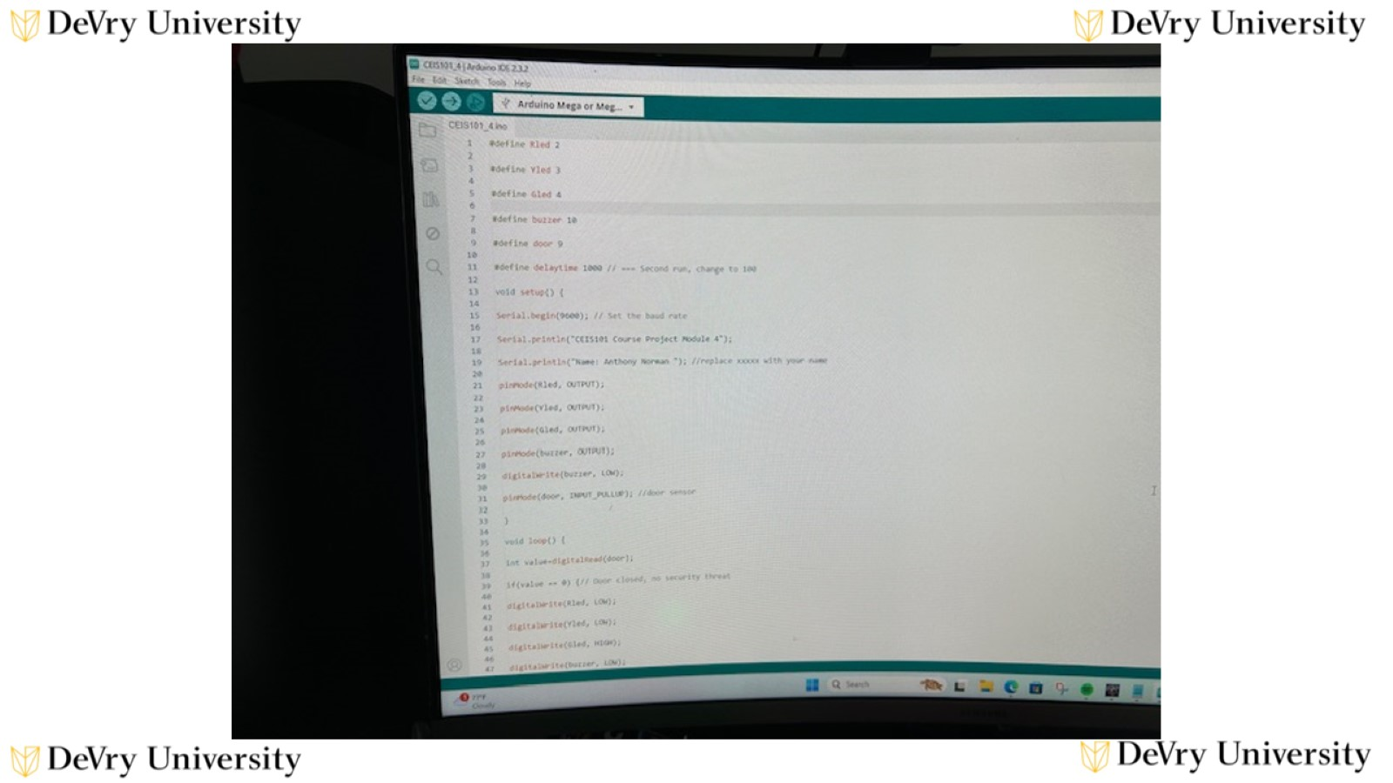

Slide 15
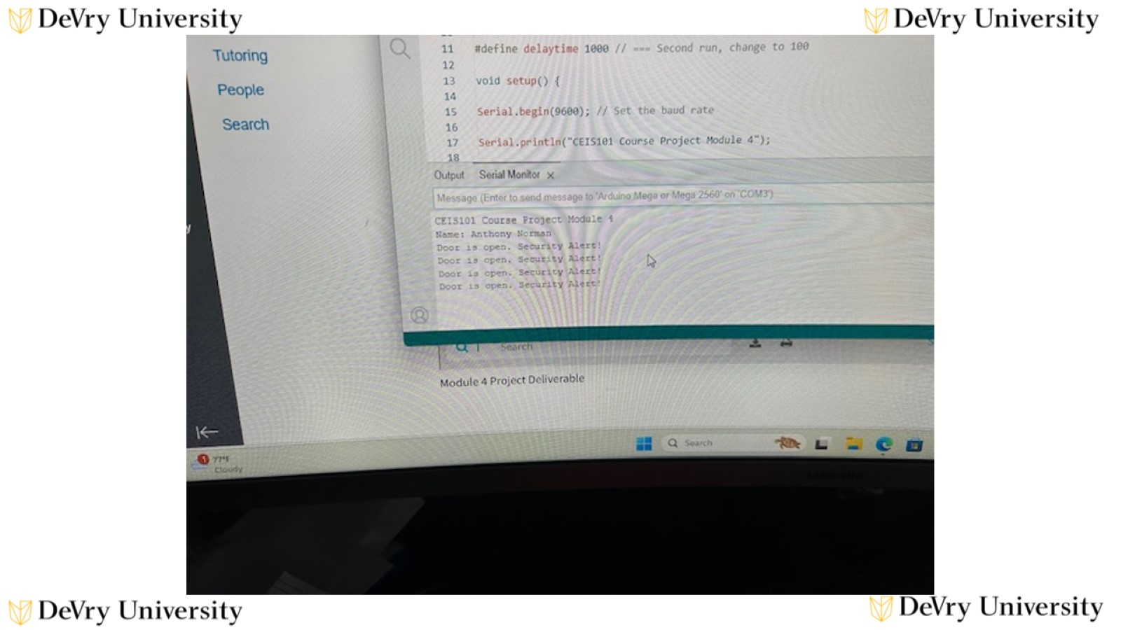

Slide 16
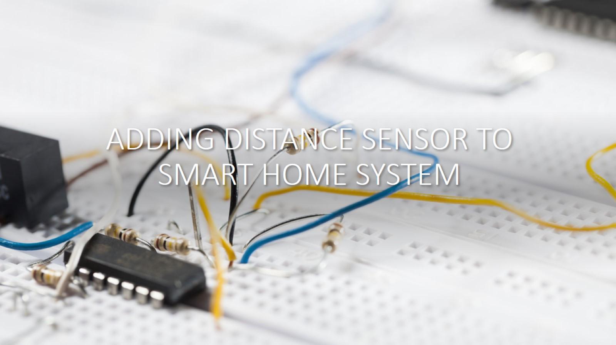
ADDING DISTANCE SENSOR TO SMART HOME SYSTEM

Slide 17
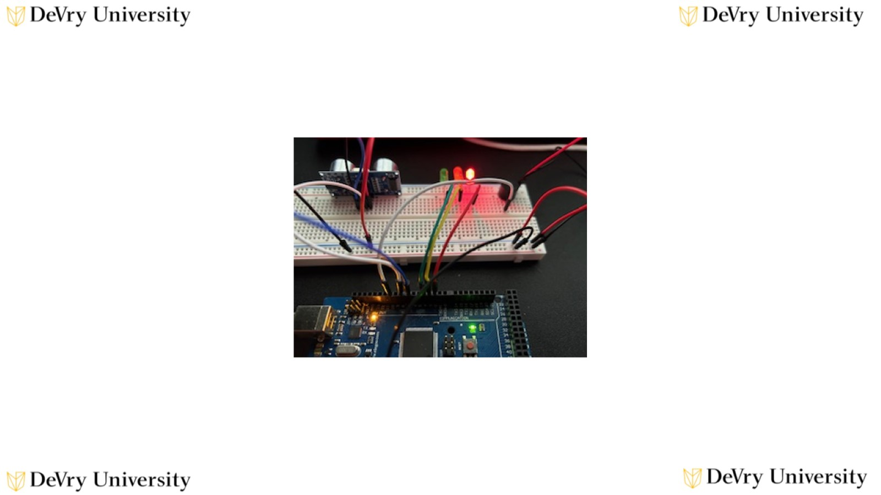

Slide 18
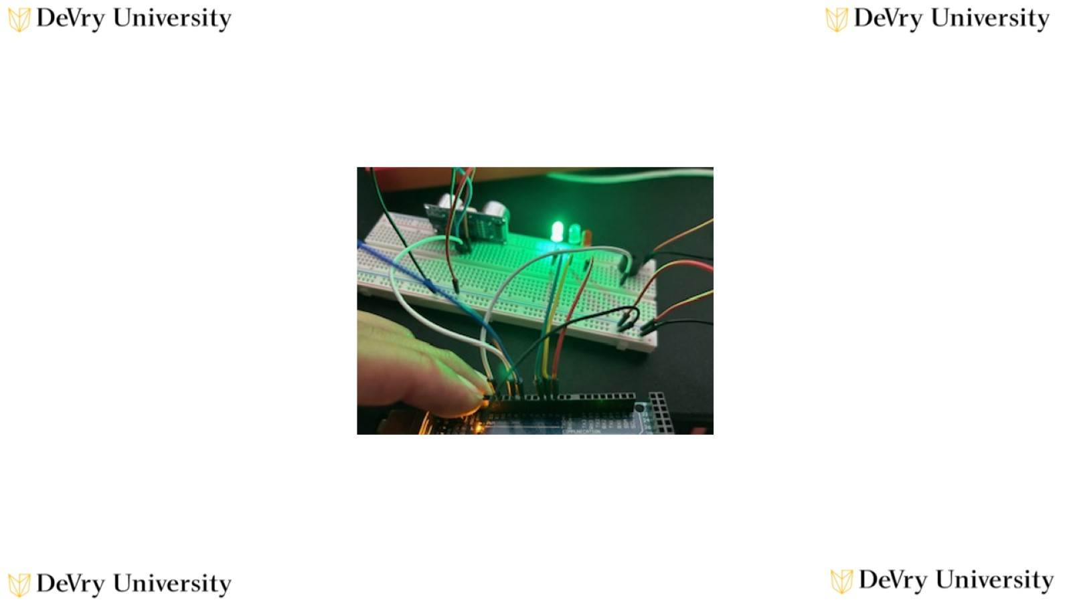

Slide 19
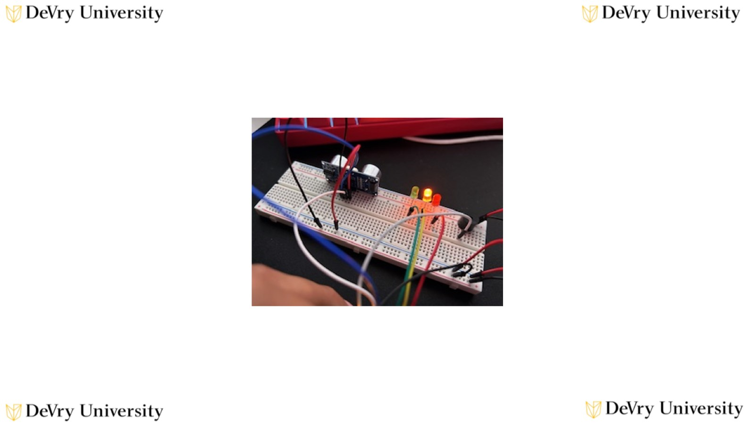

Slide 20
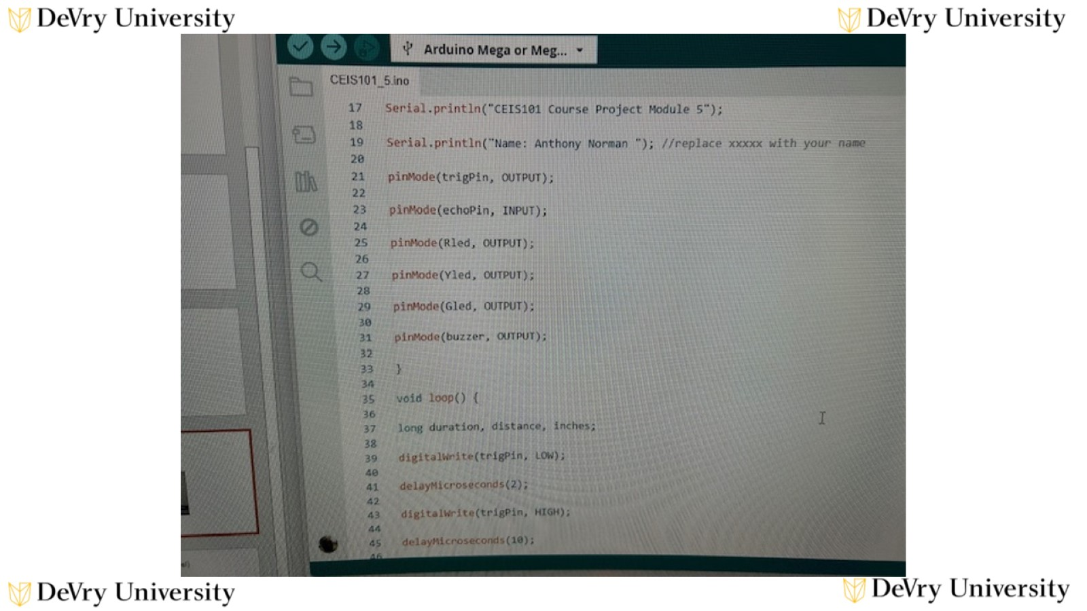

Slide 21
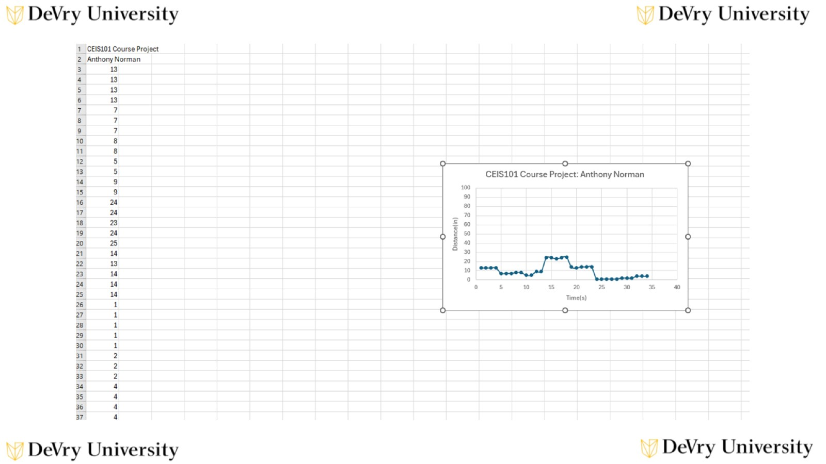

Slide 22

ADDING AUTOMATED LIGHT TO SMART HOME SYSTEM

Slide 23
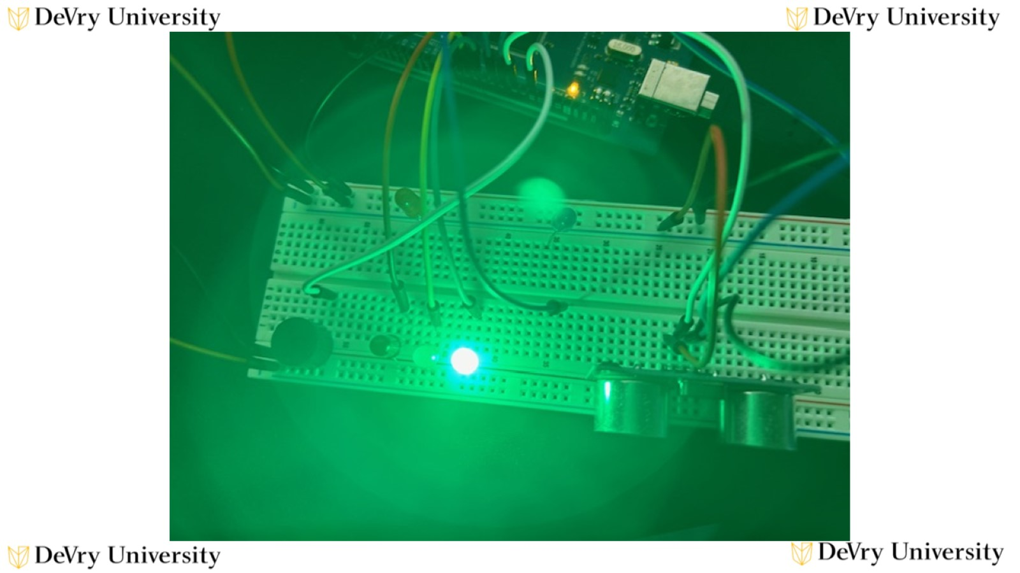

Slide 24
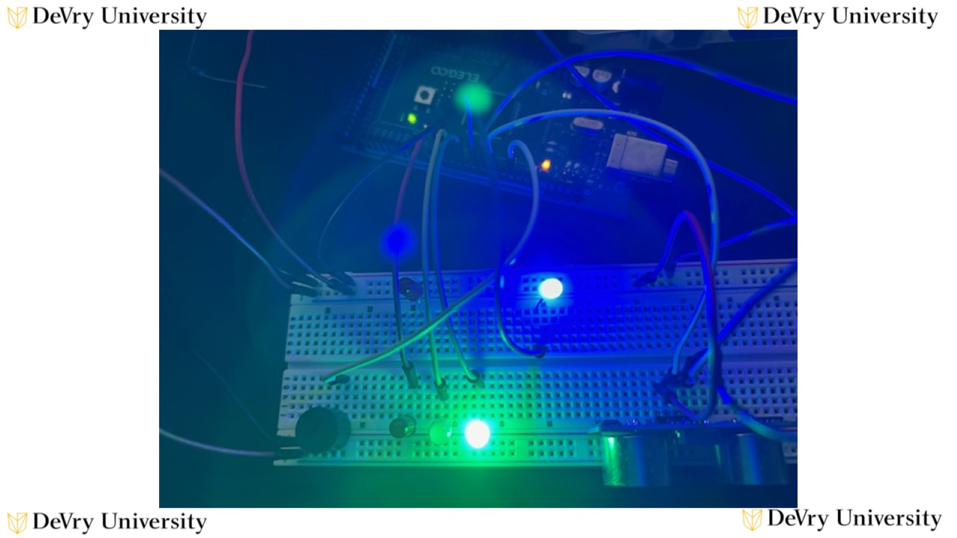

Slide 25
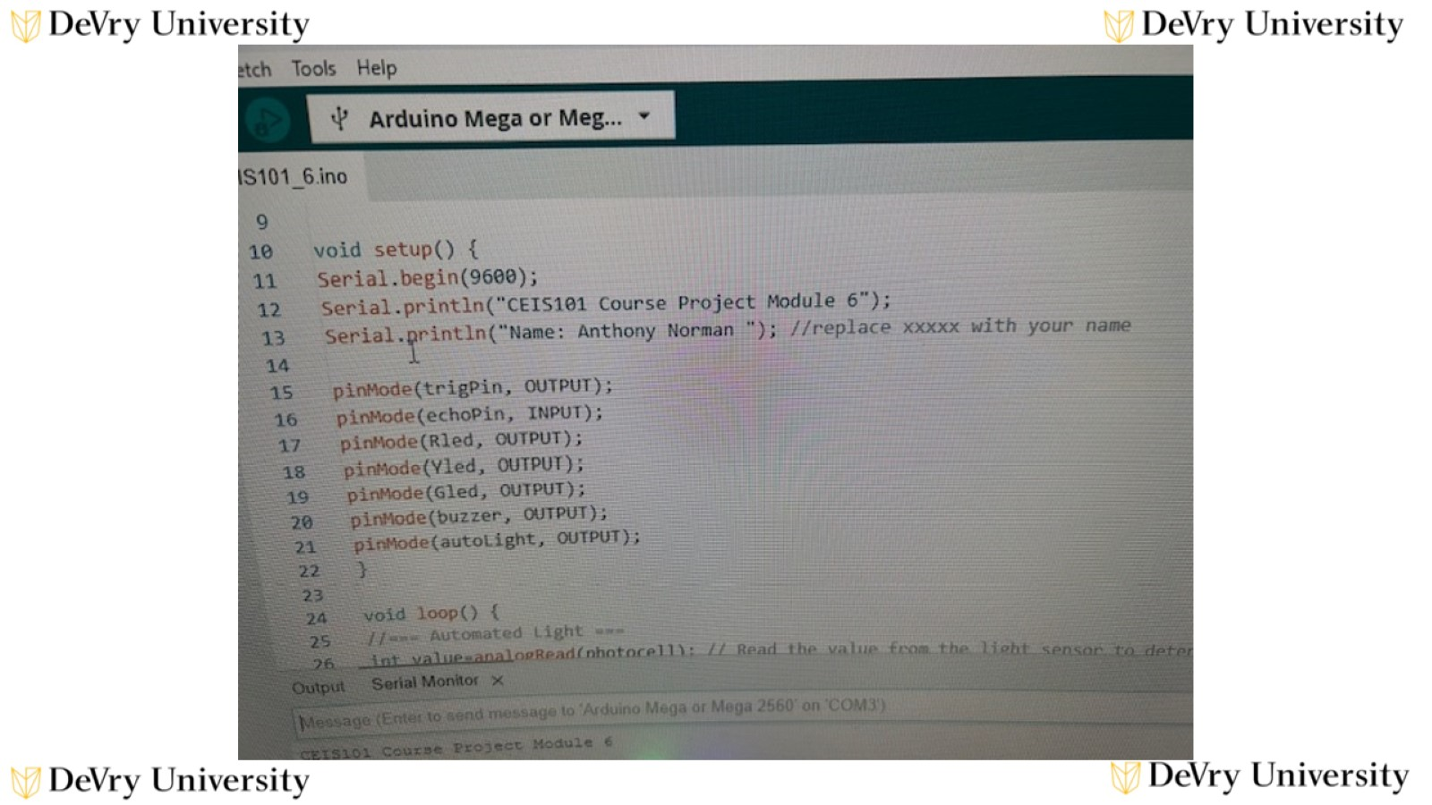

Slide 26
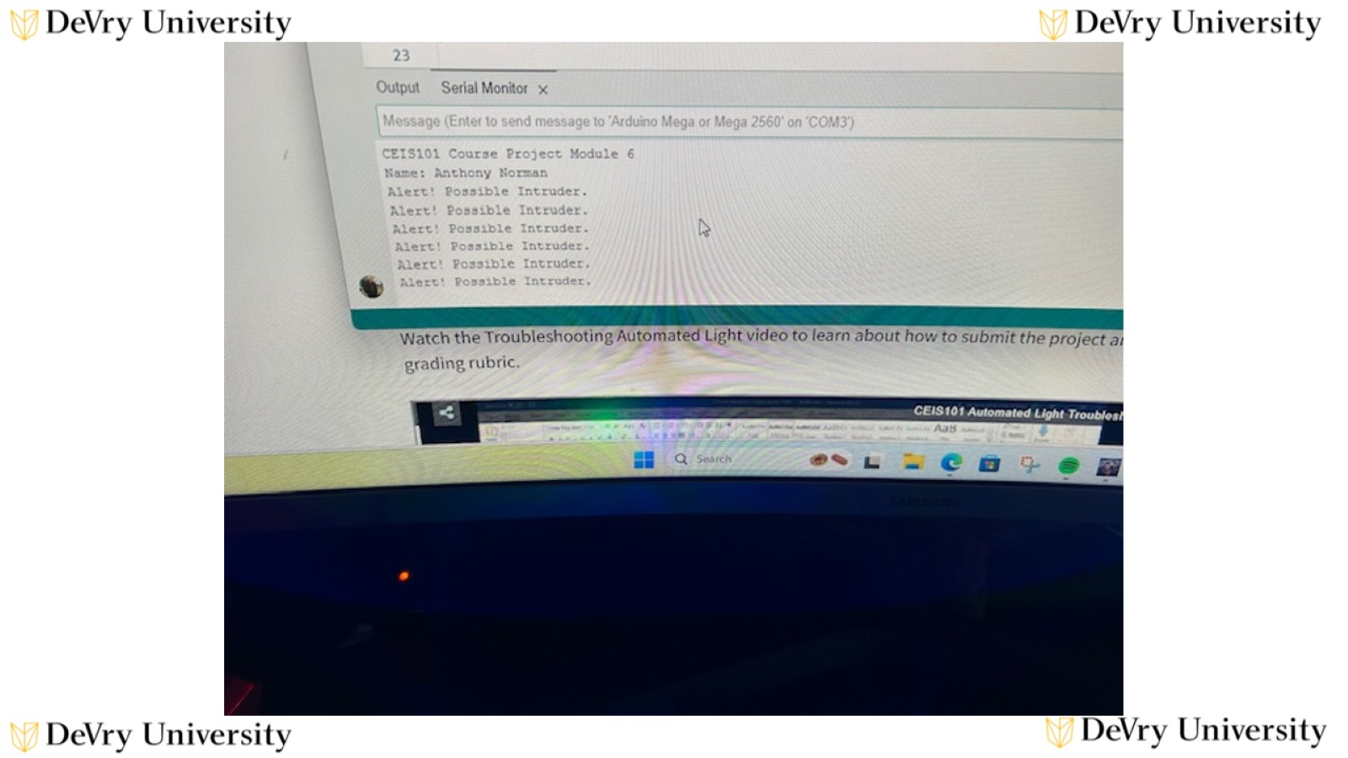

Slide 27

Challenges/Lessons Learned

Slide 28

Career Skills

Slide 29

Conclusion

Slide 30
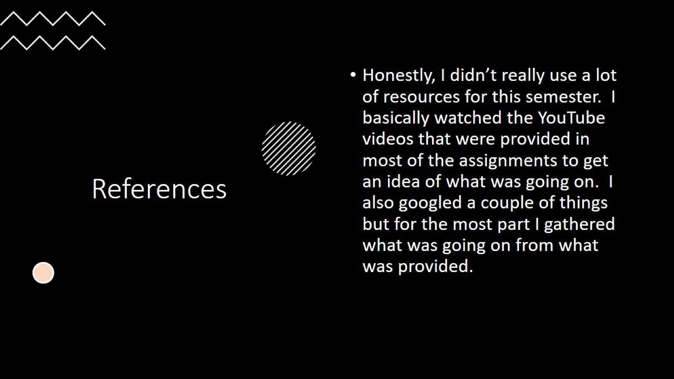
References

